Slide 1
Programming paradigms & SCala Lecture 1

Slide 2
Today's goal
Goal 1: What is functional programming and why would you use it?
Goal 2: Get familiar with Scala, a language that supports both object-oriented programming and functional programming.
Why these goals: by learning when to use a functional programming style you will be a more efficient and effective programmer!
Notes:
De vraag die we beantwoorden in de introductie.

Slide 3
Why would you learn functional programming?
To answer this question in more detail we need a bit of history.
And we need to know what a paradigm is.
Notes:
De vraag die we beantwoorden in de introductie.

Slide 4
What is a paradigm?
Comprehensive pattern of thinking
What basic rules of programming do you know?
Sequence of execution of code?
Predictability?
How do objects behave?
How do functions behave?
Notes:
Begrip paradigma bespreken
Voorkennis activeren door praten over standaardgedrag van programmeertalen

Slide 5
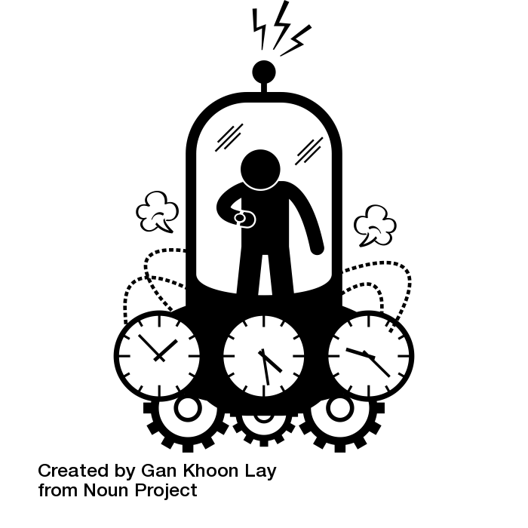
Let's take a trip through time
Now
Notes:
Wijs op tijdlijn rechts

Slide 6
Let's take a trip through time
1804
1837
1948
1950
1958
1963
1970
Now
Notes:
Eerste bestemming: 1804

Slide 7
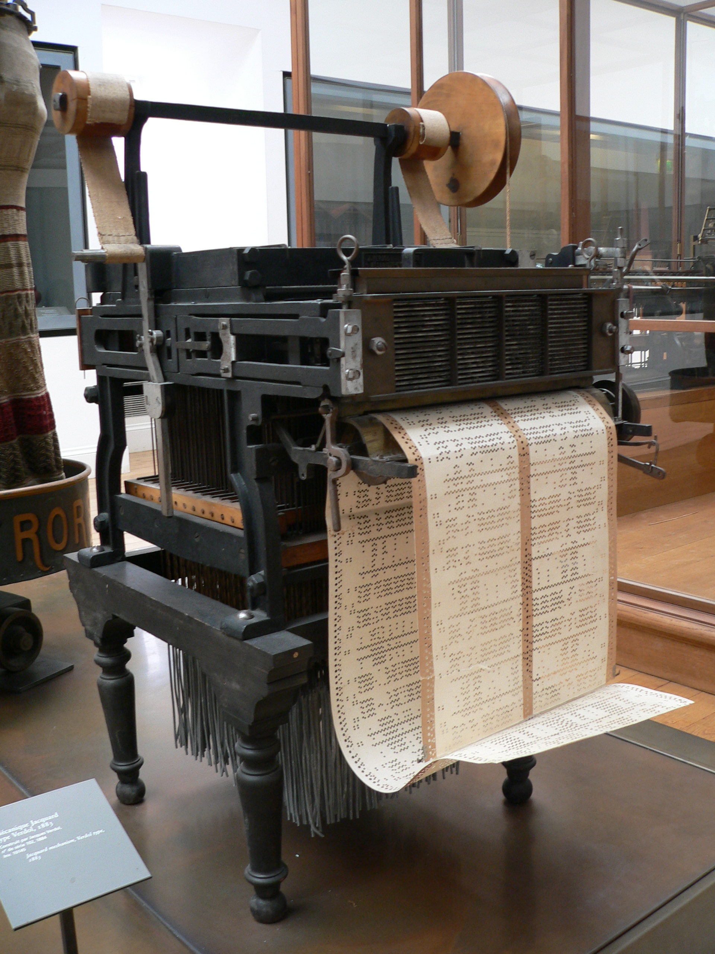
Jacquard loom
1804
Early programmable machine.
Patterns for weaving can be programmed by punching holes in paper.
First computer?
First programming language?
1837
1948
1950
1958
1963
1970
Now
Notes:
Wel programmeerbaar, maar geen berekeningen!
Misschien wel een eerste taal

Slide 8
Back in the time machine
1804
1837
1948
1950
1958
1963
1970
Now
Notes:
Even stilstaan bij het feit dat we tijdreizen

Slide 9
Back in the time machine
1804
1837
1948
1950
1958
1963
1970
Now
Notes:
Volgende bestemming 1837

Slide 10
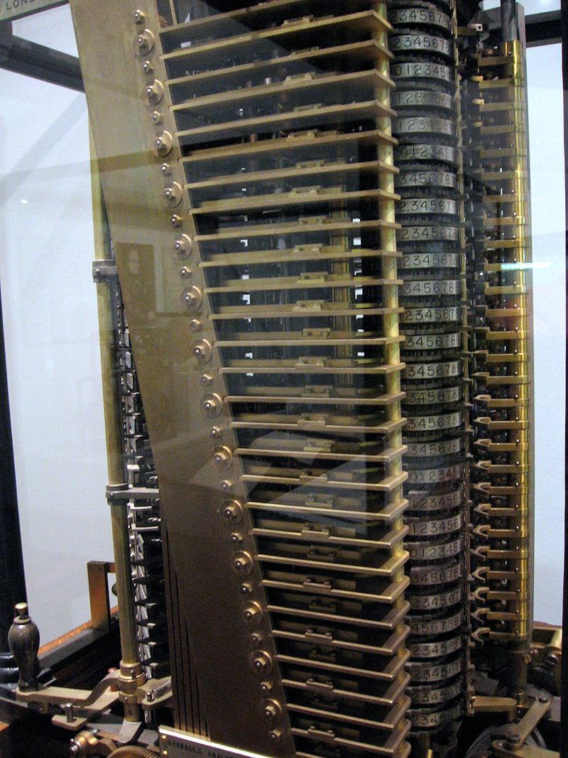
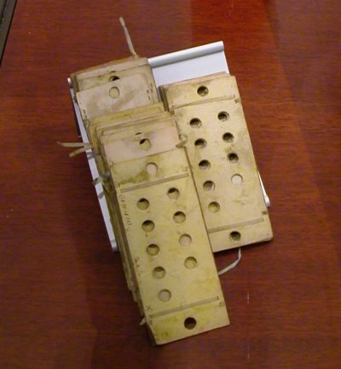
Paradigm 1: Imperative programming
Machine:
1804
Analytical Engine by Charles Babbage
First machines that compute designed, never actually built.
Can compute the same as your code nowadays... but takes long!
Code consists of statements, if conditions and loops.
1837
1948
1950
1958
Code snippet:
Imperative means commanding, you instruct the machine what to do with punch cards.
1963
1970
Now
Notes:
Eerste echte computer. Code doormiddel van gaatjes in papier.
Heeft if conditities en loops!

Slide 11
Back in the time machine
1804
1837
1948
1950
1958
1963
1970
Now
Notes:
Volgende bestemming 1948

Slide 12
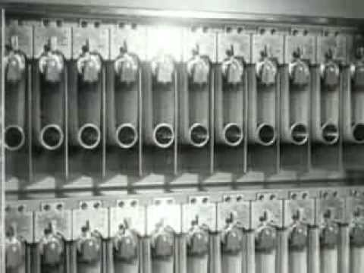
Het grootste mechanische brein van de wereld
1804
Punch card machines were used in the 20th century.
First by governments in the military
Later by large corporations.
1837
1948
1950
1958
1963
1970
Now
Notes:
Tegenwoordig zelfde berekening in milliseconden.
Programmeren door ponskaarten. Anders voor iedere machine. Veel handwerk.
Al snel kwam er een oplossing om gestructureerder te programmeren.

Slide 13
Back in the time machine
1804
1837
1948
1950
1958
1963
1970
Now
Notes:
Volgende bestemming 1950

Slide 14
GOTO & assemblers
1804
Assemblers took over the role of people punching holes cards. They are a simple version (or a predecessor) of a compiler.
Assemblers help by making code more readable and reusing code.
MOV AX, 00 ; Initializing AX to 0 MOV BX, 00 ; Initializing BX to 0 MOV CX, 01 ; Initializing CX to 1 L20: ADD AX, 01 ; Increment AX ADD BX, AX ; Add AX to BX SHL CX, 1 ; shift left CX, this in turn doubles the CX value JMP L20 ; repeats the statements
JMP command is also called GOTO, it jumps to a line or label.
1837
1948
1950
1958
1963
1970
Now
Notes:
GOTO Hell: Is dit programma ooit klaar? Geen infinite loop?

Slide 15
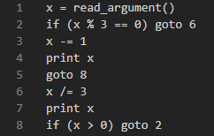
Paradigm 2: Structured programming
1804
Does this program ever finish?
1837
1948
1950
1958
1963
1970
Now
Notes:
GOTO Hell: Is dit programma ooit klaar? Geen infinite loop?

Slide 16
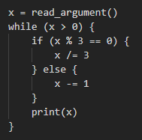
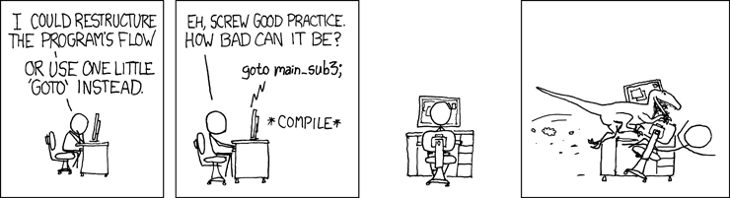
Paradigm 2: Structured programming
1804
Does this program ever finish?
1837
1948
1950
1958
1963
1970
Now
Notes:
GOTO Hell: Is dit programma ooit klaar? Geen infinite loop?
https://xkcd.com/292/

Slide 17
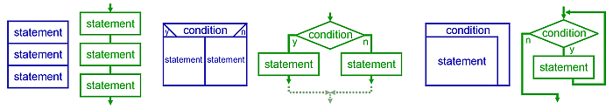
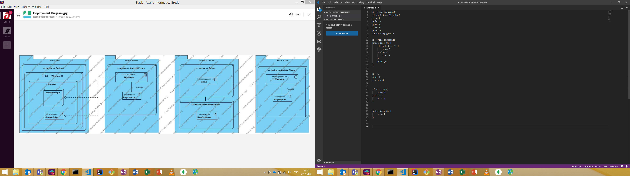
Paradigm 2: Structured programming
1804
Three ways in which a program can flow.
Always enter on the top and exit on the bottom of a block: no more GOTO!
1837
Sequence
Condition
Iteration
1948
1950
1958
1963
1970
Now
Notes:
Drie manieren van flow, maar altijd van boven naar beneden.
https://en.wikipedia.org/wiki/Structured_programming

Slide 18
Paradigm 2: Structured programming
1804
Algol, Pascal and Ada are some examples of languages first designed with this paradigm in mind. This is some sample Algol code:
1837
1948
COMMENT define the sieve data structure ;
INTEGER ARRAY candidates[0:1000];
INTEGER i,j,k;
COMMENT 1000 to protect against strict evaluation of AND ;
FOR i := 0 STEP 1 UNTIL 1000 DO
BEGIN
COMMENT everything is potentially prime until proven otherwise ;
candidates[i] := 1;
END;
1950
1958
1963
1970
Now
Notes:
Drie manieren van flow, maar altijd van boven naar beneden.
https://en.wikipedia.org/wiki/Structured_programming

Slide 19
Back in the time machine
1804
1837
1948
1950
1958
1963
1970
Now
Notes:
Volgende bestemming 1963

Slide 20
Paradigm 3: Object oriented programming
1804
This one you know!
Developed in the 60's: Simula was the first OO language, made for simulations of for example business processes or computer chip design.
Became more widely used in 80's and 90's. Older languages (Pascal, Fortran, Algol) also started implementing OO features.
Examples of languages with OO features:
Python
Ruby
Java
Scala
C++
C#
PHP
What are the key concepts in OO programming?
1837
1948
1950
1958
1963
1970
Now
Notes:
Vraag naar OO concepten:
Encapsulation
Inheritance, polymorphism, composition
Abstraction (interfaces)
Gang of four design patterns

Slide 21
Paradigm 3: Object oriented programming
1804
What are the key concepts in OO programming?
Still uses features from the imperative paradigm (variables) and the structured programming paradigm (for, if, while, …).
Classes and objects (instances of classes)
Encapsulation (private, protected, public)
Polymorphism (inheritance, composition & delegation)
Abstraction (interfaces, abstract classes)
Gang of four design patterns
All features are designed to make writing large and complex programs easier.
1837
1948
1950
1958
1963
1970
Now
Notes:
Vraag naar OO concepten:
Encapsulation
Inheritance, polymorphism, composition
Abstraction (interfaces)
Gang of four design patterns

Slide 22
Back in the time machine
1804
1837
1948
1950
1958
1963
1970
Now
Notes:
Volgende bestemming 1970 (eerst nog een stapje verder in de tijd)

Slide 23
Paradigm 4: Declarative programming
1804
Do you always write explicit machine instructions in code?
For example: for (...), if (…),
1837
1948
1950
1958
1963
1970
Now
Notes:
Laat studenten nadenken over of ze declaratief programmeren.

Slide 24
Paradigm 4: Declarative programming
1804
Do you always write explicit machine instructions in code?
For example: for (...), if (…),
1837
SELECT *
FROM Client JOIN Address ON Client.ClientID = Address.ClientID
GROUP BY City
ORDER BY PostalCode
You declare what you want computed, not how you want it computed.
Contrary to Imperative programming!
SQL was created in the 70's
1948
1950
1958
1963
1970
Now
Notes:
Laat studenten nadenken over of ze declaratief programmeren.

Slide 25
Back in the time machine
1804
1837
1948
1950
1958
1963
1970
Now
Notes:
Volgende bestemming 1958 (stap terug in de tijd)

Slide 26
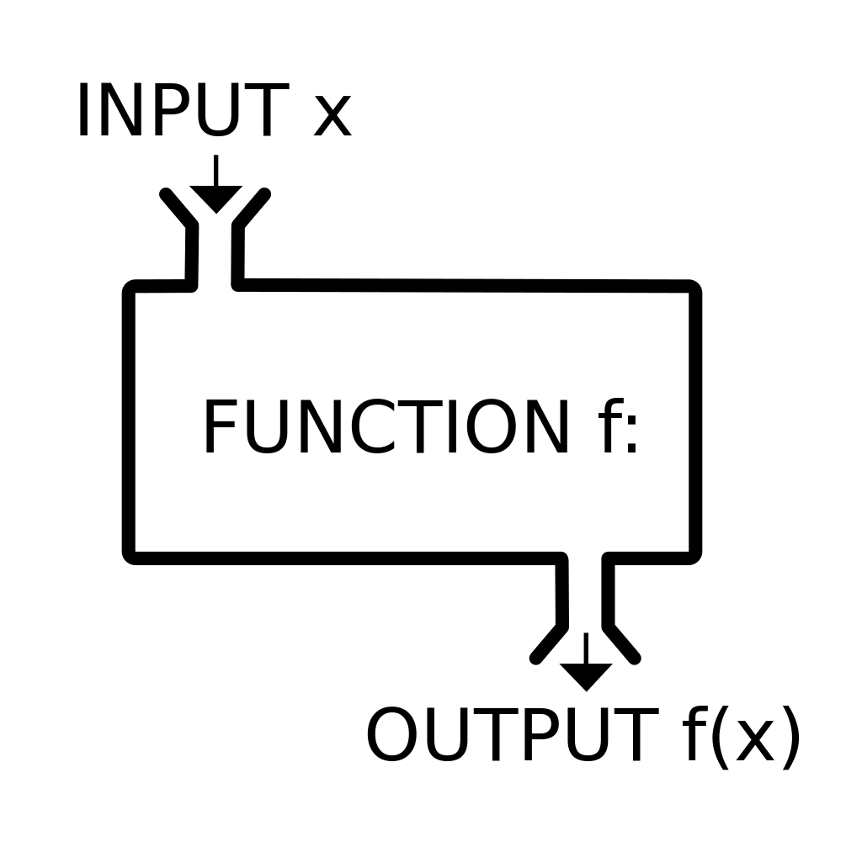
Paradigm 5: Functional programming
1804
Functions are first class citizens: they behave the same as variables!
Idempotent: functions have no side effects
If purely functional: declarative
Examples:
Fat arrow (=>) functions in JavaScript
Serverless architecture (AWS Lambdas)
Chaining query steps in C# LINQ
Why would you use only pure functions?
1837
1948
1950
1958
1963
1970
Now
Notes:
https://en.wikipedia.org/wiki/Function_(mathematics)

Slide 27
Paradigm 5: Functional programming
1804
Why would you use only pure functions?
No side effects:
Unit tests are easier. Once a function works, it will work forever. It's not dependent on some state.
Parallelization. It's easier to keep track of which function can be run: once the input is known it can be run!
Lazy evaluation & memorization. Only run a function when it's needed. Then remember the outcome, so don't run it again for the same input!
Scalability. Multiple instances of the function can run simultaneously.
1837
1948
1950
1958
1963
1970
Now
Notes:
https://en.wikipedia.org/wiki/Function_(mathematics)

Slide 28
Finally... back home
1804
1837
1948
1950
1958
1963
1970
Now
Notes:
Terug naar het heden

Slide 29
Overview
Imperative
Punch cards, Assembly
Declarative
SQL
1804
1837
Structured
C, Pascal
Functional
Haskell, Javascript, Scala
1948
1950
Object Oriented
Java, C#, C++, Javascript, Scala
1958
Logic
Prolog (you'll see this in AI)
1963
1970
Now
Notes:
Volgende bestemming 1948

Slide 30
Current trends
1804
OO, Imperative dominate programming languages (check https://www.tiobe.com/tiobe-index/)
But functional is making a comeback.
Sometimes a functional approach is simply clearer and shorter.
CPU's cannot be made smaller, but we can make more cores: parallelization.
The current trend is combining OO, Imperative, Functional.
Example: Lambda functions (fat arrow =>) in most OO languages.
The goal for this course: find the right tool for the job.
To learn this we will drag you out of your comfort (OO) zone.
1837
1948
1950
1958
1963
1970
Now
Notes:
https://insights.stackoverflow.com/survey/2018/

Slide 31
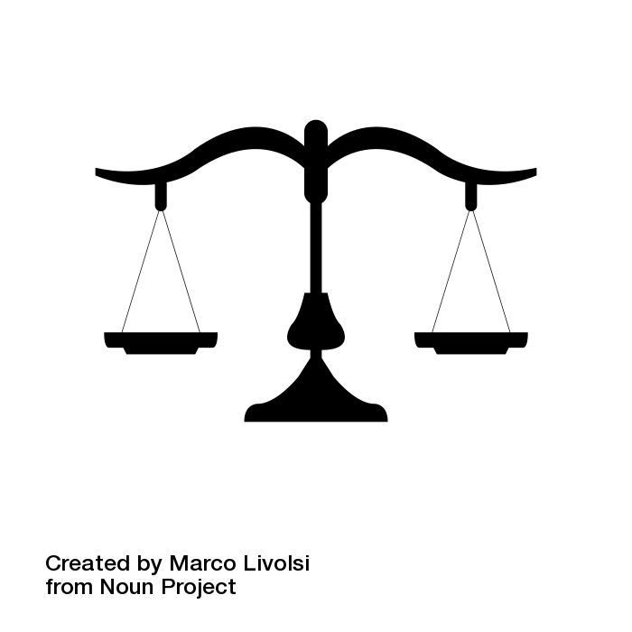
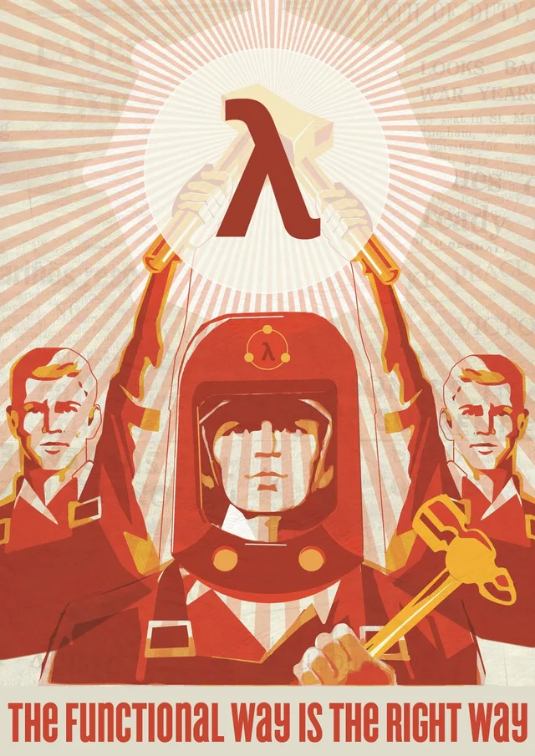
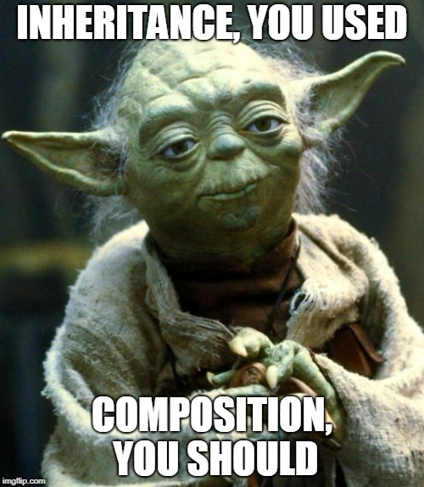
Mix 'n Match
Object Oriented
versus
Functional
1804
1837
1948
1950
1958
1963
1970
Now
Notes:
Balance the use of OO and functional
https://www.reddit.com/r/ProgrammerHumor/comments/26rzo3/the_functional_way/
http://rcardin.github.io/design/programming/2018/04/02/template-method-pattern-revised.html

Slide 32
SCala

Slide 33
ScaLa
Scalable Language: scales with the user's needs
Created as an answer to critism of Java.
You can program in OO and functional style.
First some warming up
Then we write a game: rock paper scissors.

Slide 34
Warming Up
Go through the exercises on BB
Exercise 12 is writing a simple reactive programming library (RxAvans) in Scala.
The first implementation can be comfortably in your OO-world.
During the lectures we will refactor the code to the functional starting code of the exam.

Slide 35
Wrap up
We've seen five programming paradigms:
Imperative
Structured
Object Oriented
Declarative
Functional
Goal 1: What is functional programming and why would you use it?
Goal 2: Get familiar with Scala, a language that supports both object oriented programming and functional programming.
Keep the RxAvans code for next lecture! We'll change parts of the game to work in a functional approach in each lecture!
Imperative
Declarative
Structured
Functional
Object Oriented
Logic
Notes:
https://en.wikipedia.org/wiki/Connect_Four

